Slide 1
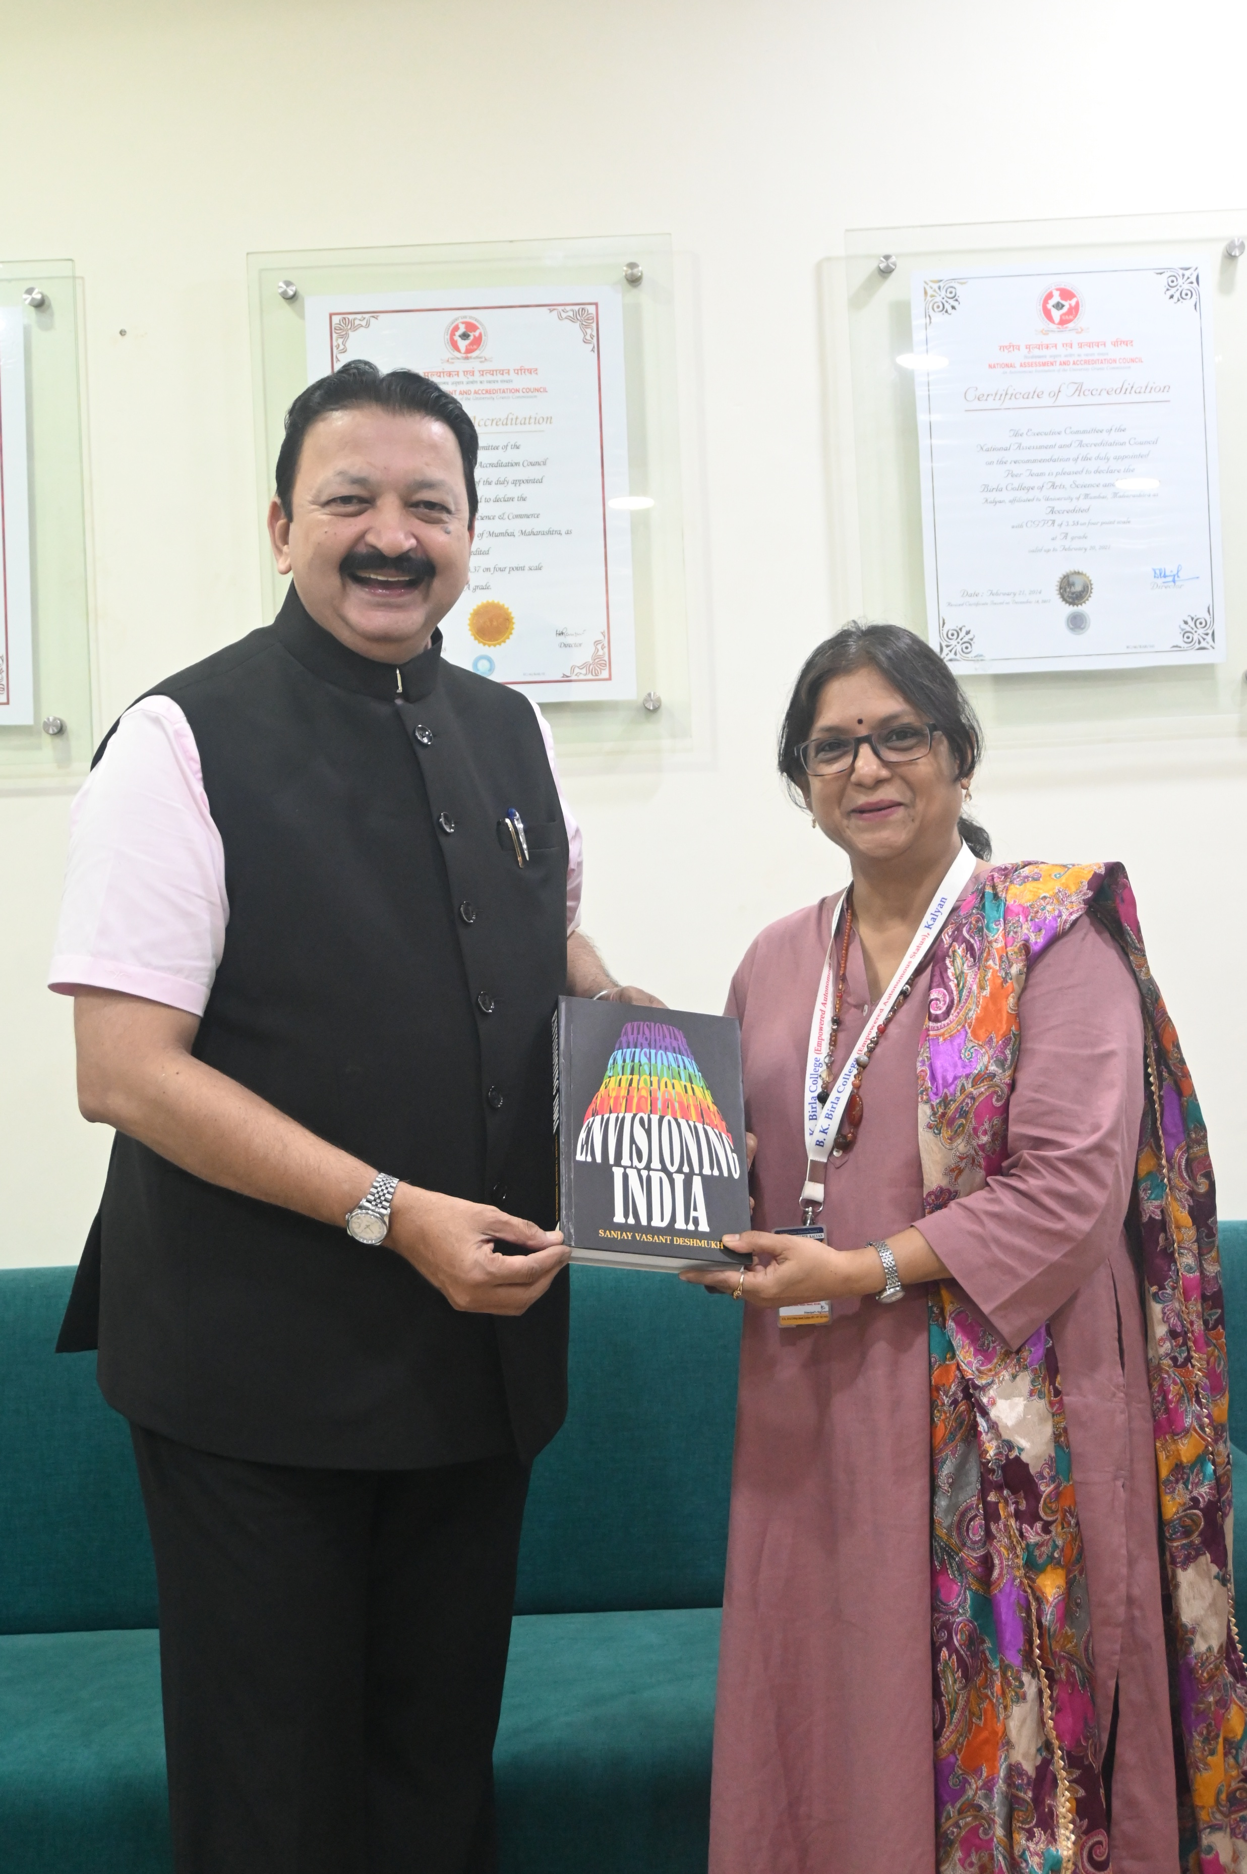
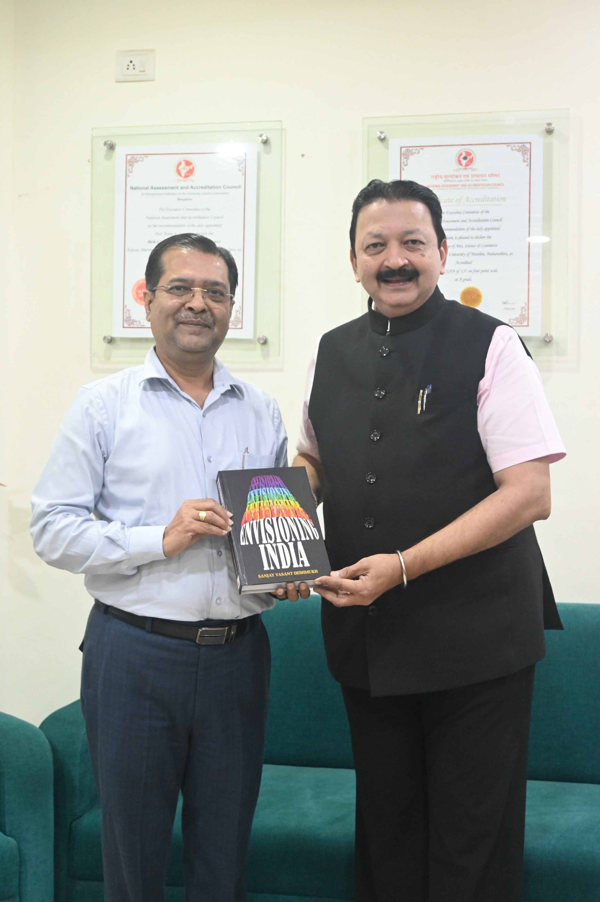
Department of Environmental Sciences celebrates World Ozone Day

Slide 2
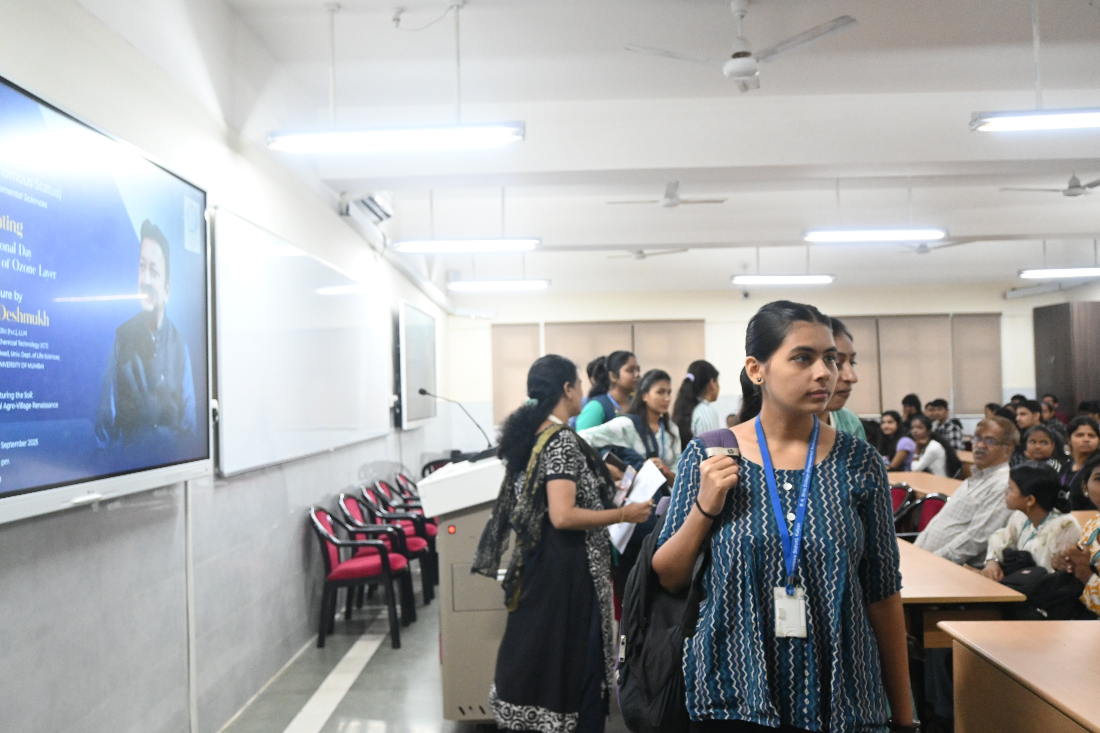
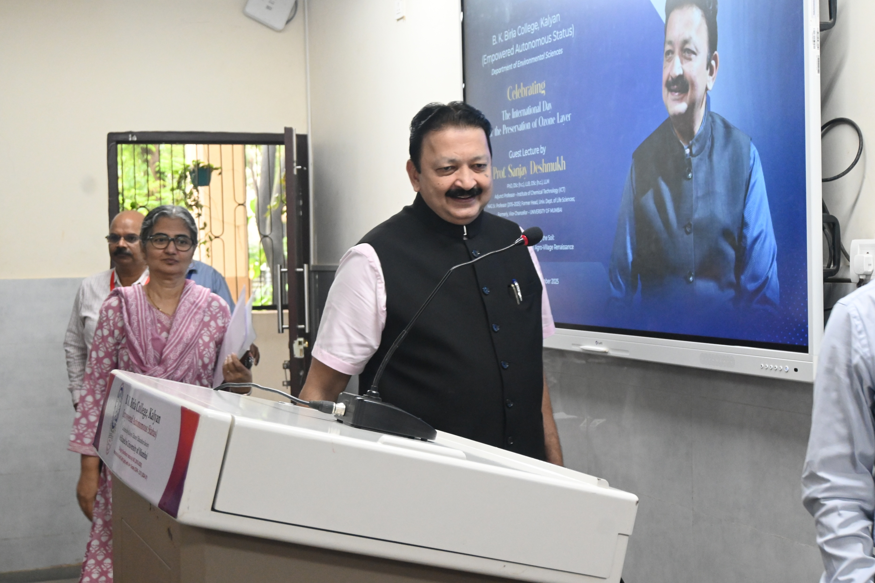
Department of Environmental Sciences celebrates World Ozone Day

Slide 3
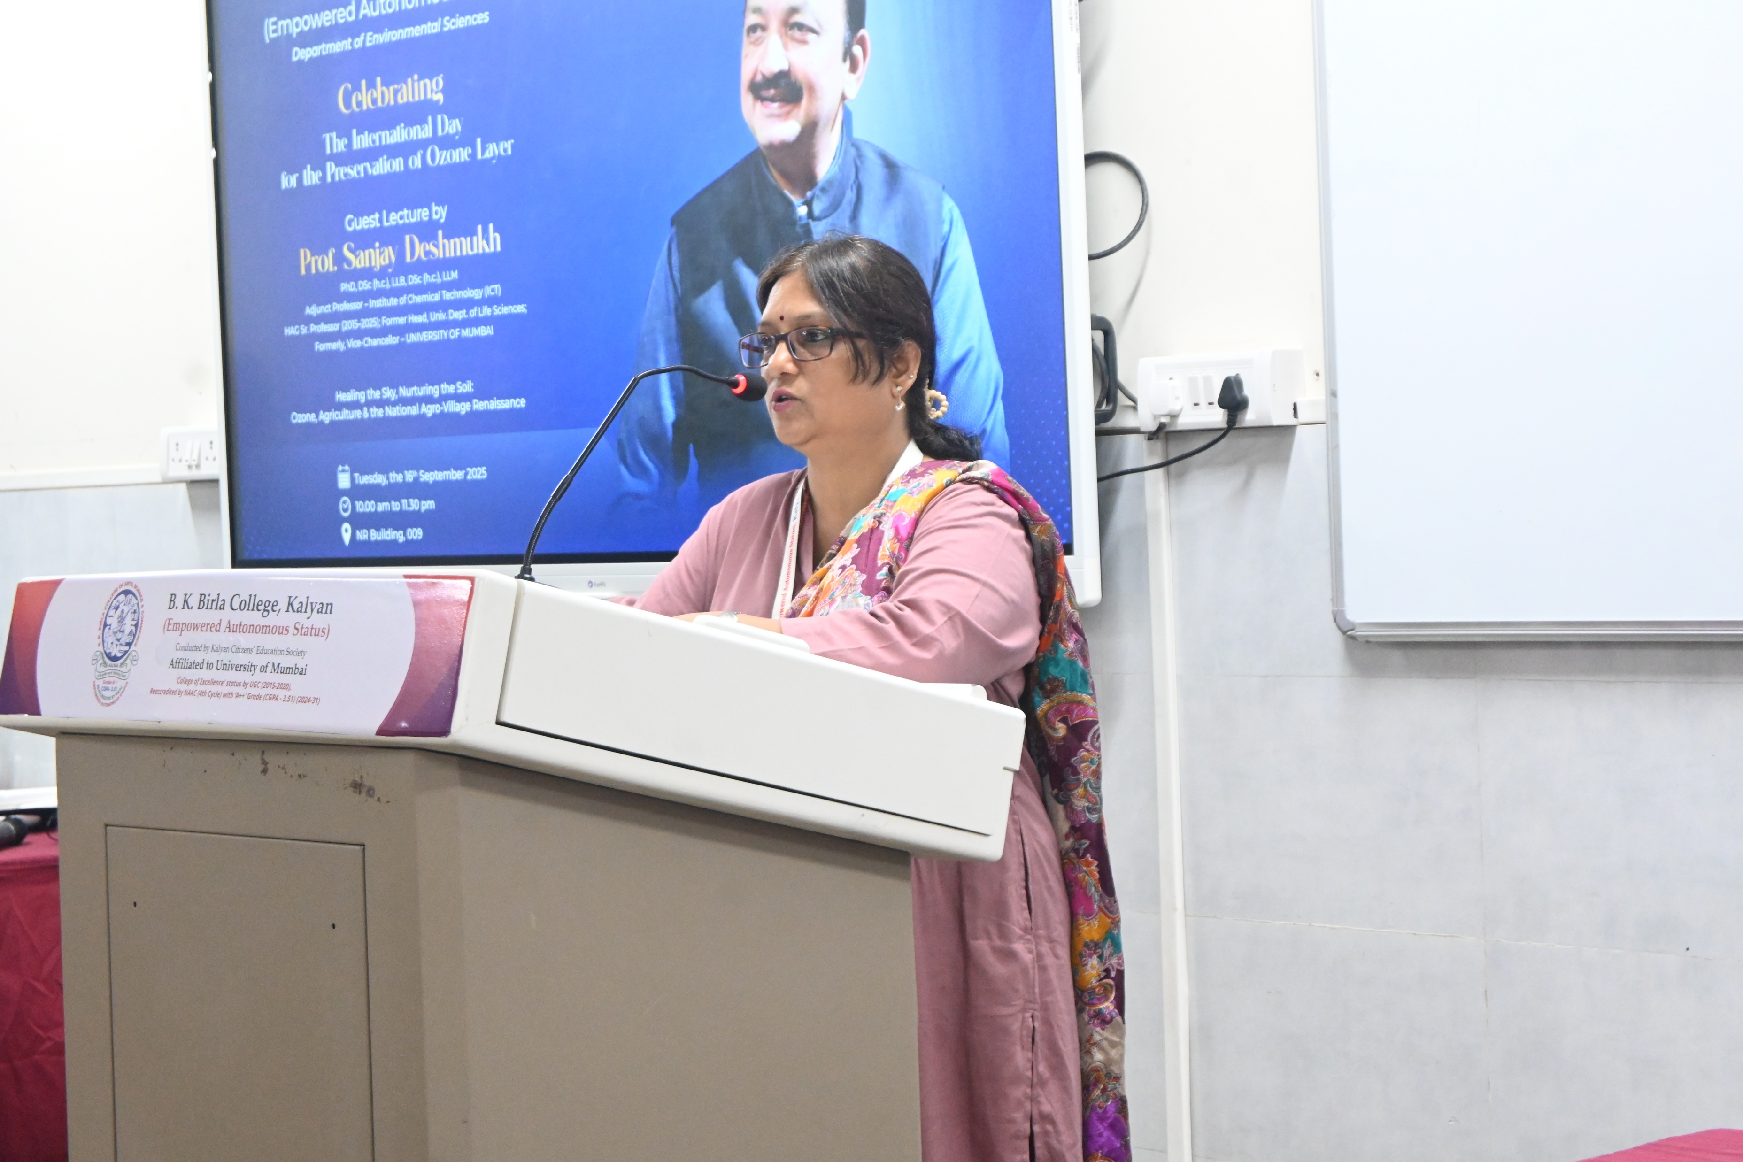
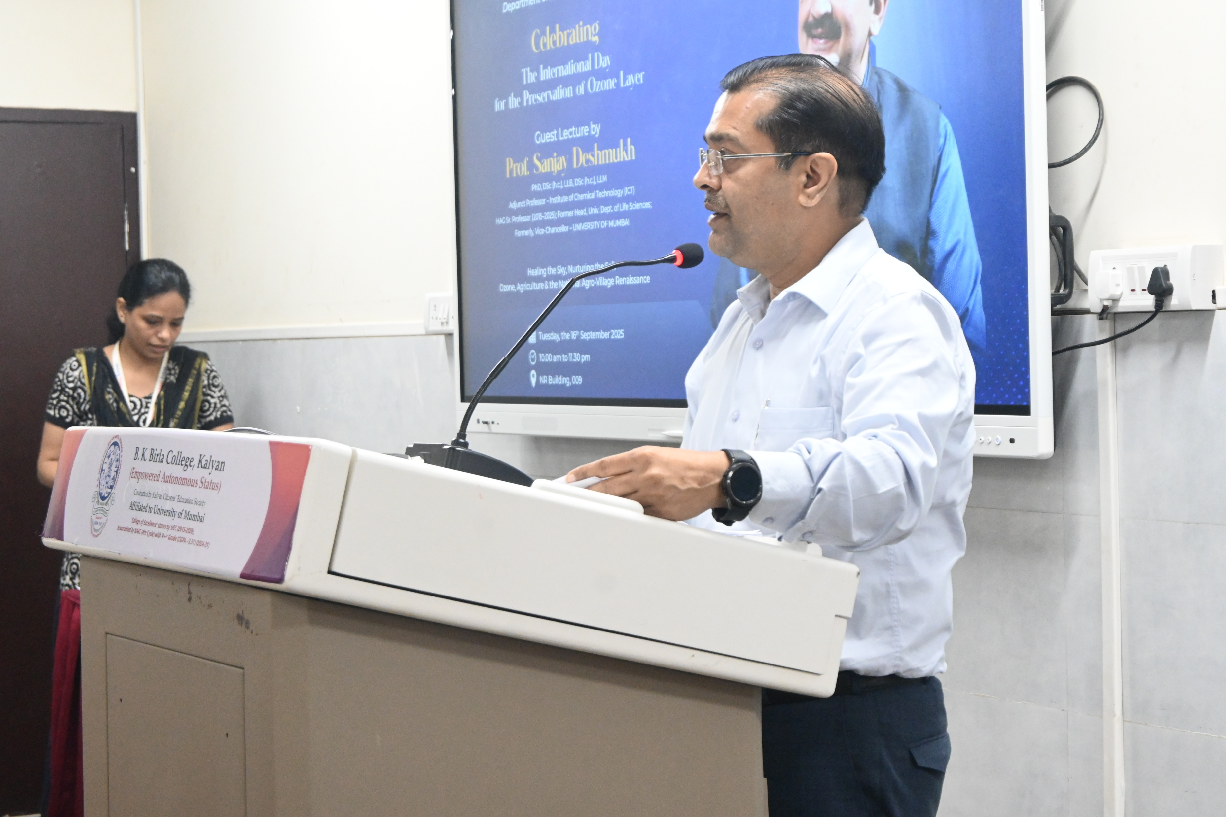
Department of Environmental Sciences celebrates World Ozone Day

Slide 4
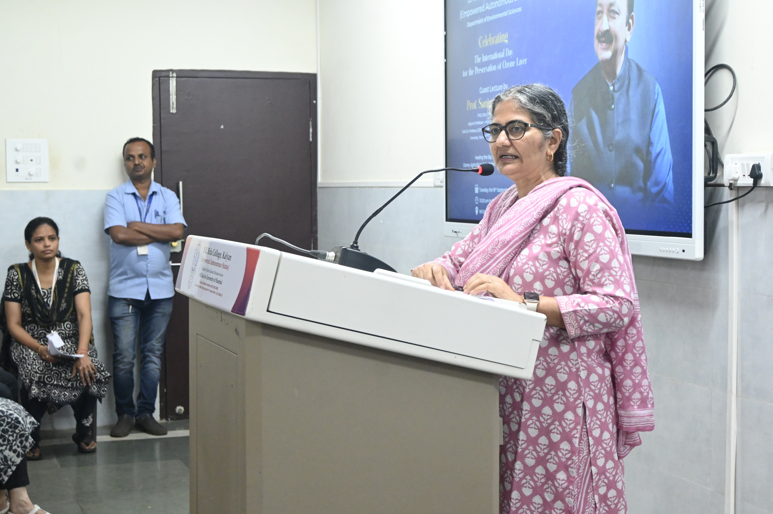
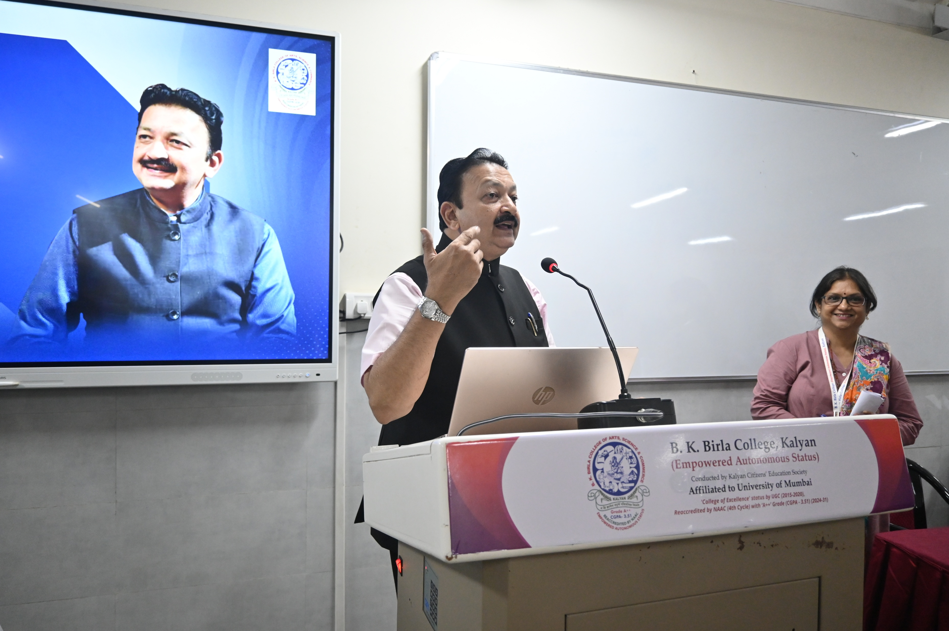
Department of Environmental Sciences celebrates World Ozone Day

Slide 5
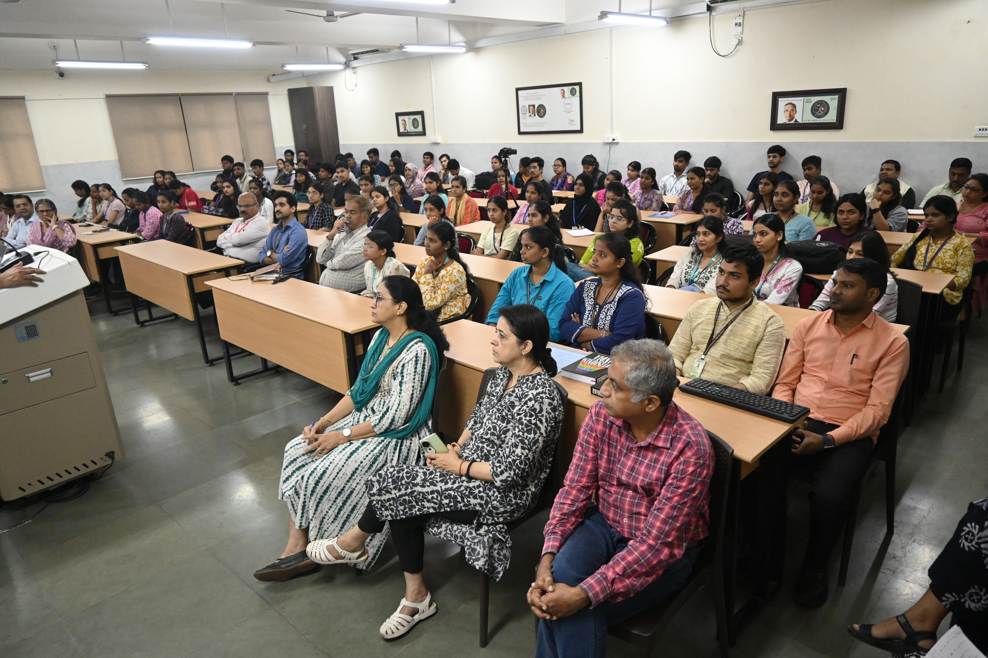
Department of Environmental Sciences celebrates World Ozone Day

